Slide 1
Module 4
Goods and Services Tax

Slide 2
Pre-gst Tax structure in India
Tax Structure
Direct Tax
Income Tax
Wealth Tax
Indirect Tax
Central Tax
State Tax
Excise
Service Tax
Custome
VAT
Entry Tax, luxury tax, Lottery Tax, etc.

Slide 3
Subsuming of Existing Taxes
CGST
Central Excise
Additional duties of Custom (CVD)
Service Tax
SGST
VAT/sales tax
Entertainment Tax
Luxury Tax
Lottery Tax
Entry Tax
Purchase Tax
Surcharges and all cesses
IGST
CST

Slide 4



Goods Vs. Services dilemma ?
License Software in CD
Sale of Food In Restaurant
Sale
Services
Manufacturing
Notes:
There is a concept of Goods-Service Continuum; If goods and services are places on a scale with pure goods being on one side and services on the other side, most of the transactions lie some where in between having elements of goods as well as service. State government and Centre are in Court in many cases just to decide as regards the classification as goods or services. The distinction between two is getting blurred with the advent of technology. For instance software is being taxed by treating it as services as well as goods. GST appears to be much more efficient tax and may solve most of the existing inefficiencies in indirect taxation system.

Slide 5
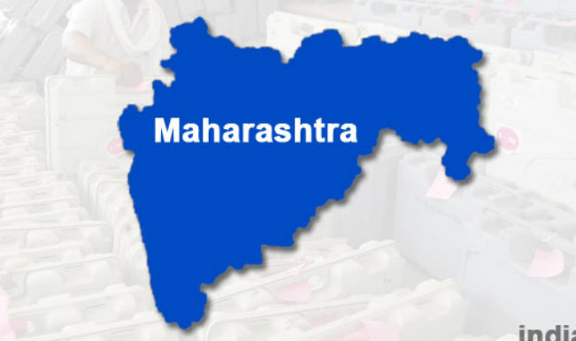
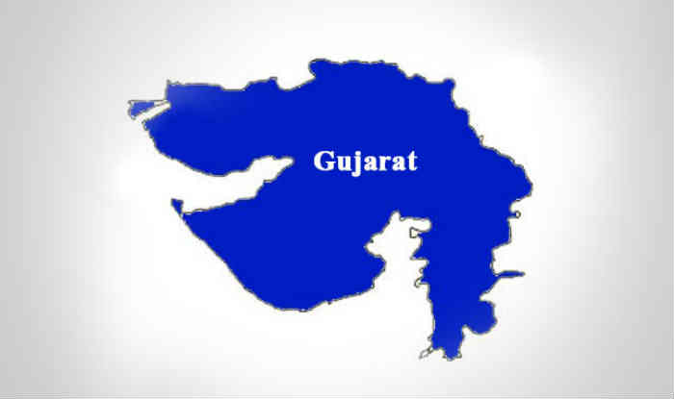
Lack of Uniformity
No Entry Tax
Entry Tax
@ NIL %
@ 4%
Value Added Tax
e.g. on Sugar
Notes:
Harmonisation in the different taxation laws of states appears to be missing many a times. Uniformity is lacking while levying VAT or entry taxes in many states. The companies try to take advantage of tax arbitrages leading to decisions being taken on the basis of tax structure rather than on the basis of pure economic reasons. All this leads to inefficiencies in the system.

Slide 6


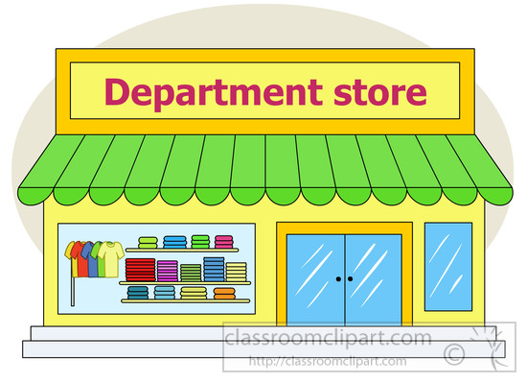

Different Points of Taxation
Limitations of current Tax regime :
Central Excise
(On Manufacturing)
Service Tax
(On provision of Service)
VAT
( On sale of Goods)
Notes:
There are different taxable events with each having issues of definitions, interpretations resulting in overlapping at many places. All this creates confusions with many of the issues reaching courts for a decisions.

Slide 7
Value Added Tax (VAT)
Value Added Tax, or otherwise called as VAT, is a multi-point tax system, wherein the tax is levied by the state government, at each level of production/distribution of goods.
In this regime, the tax is levied on the incremental value of the goods, to eliminate the cascading effect, at different levels of sale. It is a type of consumption tax, wherein the value addition made by the firm is equal to the difference between proceeds and the cost of purchases.

Slide 8
Value Added Tax(VAT)
It allows the purchaser of the goods to avail input tax credit, i.e. the tax paid at the previous stage will be deducted from the net tax liability. To avail the input tax credit under VAT system, every dealer is required to obtain registration.
In this system, the VAT is levied at different types of rates, 0% is for agricultural goods and items of social importance, 1% gold and silver jewellery, 4% raw material or inputs used in manufacturing and capital goods, 20% for luxury items and remaining items are taxed as per normal slab rate, i.e. 12.5%.

Slide 9
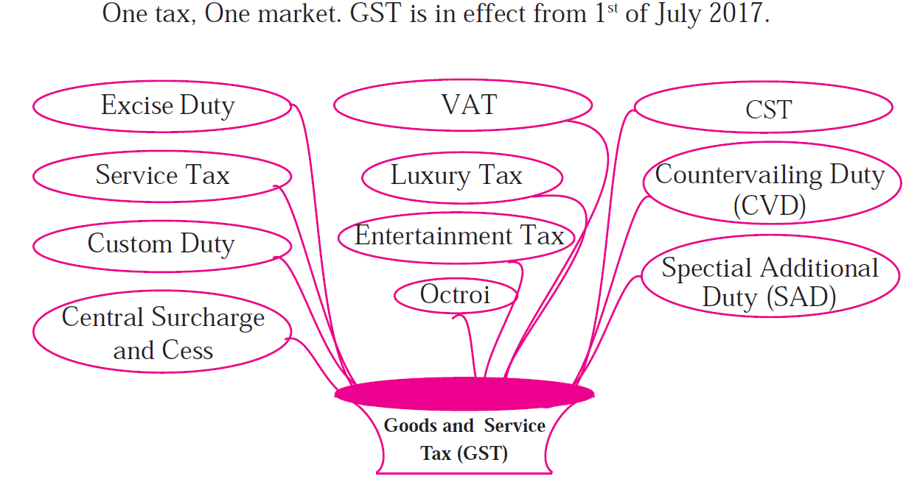
Goods and Services Tax (GST)

Slide 10
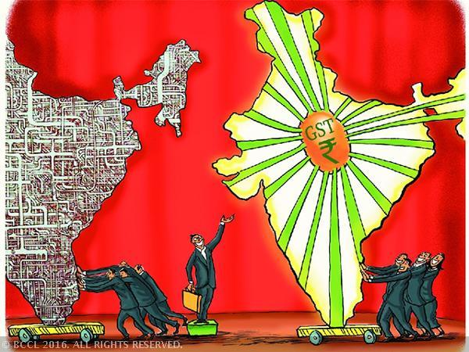
What is GST?
One Tax For
Manufacturing
Trading
Services
ONE NATION: ONE TAX
Notes:
Whether you are manufacturer, trader, dealer, service supplier- all will be considered as same i.e taxpayer. Whether you supply within the same state or anywhere in the country, the rate of tax is same, thereby obviating any need for various forms and border check points which is prevalent today.

Slide 11













The Journey to GST
First Discussion Paper was released by the Empowered Committee
The Constitution (122nd Amendment) Bill was introduced in the Lok Sabha
2006
2011
Announcement of GST for the first time was made by the then Union Finance Minister, during budget of 2006-07 that it would introduced from 1 April 2010
2009
Constitution (115th Amendment) Bill introduced and subsequently lapsed
2014
The Constitution
(One First was
Aug 2016
Hundred and
Amendment) Act enacted
May 2017
April 2017
March 2017
Sep 2016
GST Council recommends all the rules
CGST, IGST, UTGST and
Compensation Cess Acts passed
GST Council Recommends the CGST, SGST, IGST,
UTGST and Compensation Cess Act
1st GST Council Meeting
All except passed
States
J&K their
30th June 2017
SGST ACT
1st July 2017
8th July 2017
Journey Continues…
Notifying and amending rules
Dealing with IT related issues
Revision of Rates
Clarification and communication with taxpayers
GST Launched
SGST Act passed by J&K; CGST and IGST Ordinances promulgated to extend GST to J&K
True Economic Integration of India
3

Slide 12
GST Law from a Constitutional Perspective
Definition of GST
Article 366(12A)
“Goods and services tax” means any tax on supply of goods, or services or
both except taxes on the supply of the alcoholic liquor for human
consumption
Sl No | Definition | Article | Definition
1. | Goods | 366(12) | Includes all materials, commodities, and articles [Pre Existing Definition]
2. | Service | 366 (26A) | Anything other than goods [Introduced vide 101st Constitutional Amendment Act]
3. | State | 366(26B) | With reference to articles 246A, 268, 269,269A and Article 279A includes a Union territory with Legislature. [Introduced vide 101st Constitutional Amendment Act]
“Goods and Services tax” law while having unique principles, has significant elements of prior Central and State laws; and is also inspired by VAT/GST legislation of EU, Australia, Malaysia etc. along with International VAT/GST guidelines of OECD
4

Slide 13
GST Law from a Constitutional Perspective
Bill passed by Rajya Sabha on 03.08.2016 & Lok Sabha on 08.08.2016
Notified as Constitution (101st Amendment ) Act, 2016 on 08.09.2016
Key Features:
Concurrent jurisdiction for levy & collection of GST by the Centre & the States – Article 246A
Centre to levy & collect IGST on supplies in the course of inter-State trade or commerce including imports – Article 269A
Compensation for loss of revenue to States for five years on
recommendation of GSTC – Clause 19
GST on petroleum crude, high speed diesel, motor spirit (commonly known as petrol), natural gas & aviation turbine fuel to be levied from a later date on recommendations of GSTC
5

Slide 14
Why GST ?
Distinction between goods & services or mix thereof was a big problem in earlier laws/regime.
Especially in respect of Works Contract Service where both material and service is involved, things become more complex because of Reverse Charge Mechanism (RCM).

Slide 15
IMPORTANCE OF GST
GST IS APPLICABLE TO ALL GOODS & SERVICES, EXCEPT FEW.
EXCEPT AGRI, MEDICAL SERVICES AND EDUCATION, EVERYTHING IS TAXABLE UNDER GST.

Slide 16
WHY GST BETTER THAN EARLIER LAWS ?
GST may not be a very ideal for many people & for many reasons but in fact things in earlier taxation system had gone to such low & complex level, so further worsening of things was almost impossible, so hopefully things will only get better day by day.

Slide 17
Purpose of GST as per constitution
What constitutional amendment says as purpose
(1) to avoid cascading effect
(2) to have common national market.

Slide 18
Unique Concepts/Features:-
IGST/(contribution of India in GST).
DESTINATION BASED TAX
CONSUMPTION BASED TAX
COMPLIANCE RATING
RARE EXAMPLE OF STATE & CENTRAL GOVT CO-OPERATION.
GST COUNCIL- NEW POWER CENTRE
ALL DECISIONS UNANIMOUS, NEVER VOTING.
END OF INSPECTOR RAJ ?

Slide 19
WHY GST IS MUST ?
Earlier tax on tax
Exports can not be made tax free.
Under GST:- self police mechanism.
All transactions recorded in book, tax collection will go up.
Pararrel economy ratio expected to go down.
What is easy to print a currency note or CENVAT invoice ? .
Matching basis-soul of GST.
Earlier taxation under excise, vat was restricted to those transactions, now 360degree angle is required

Slide 20

Existing Indirect Tax Structure in India
Central Taxes
State Taxes
Central Excise duty
Additional duties of excise
Excise duty levied under Medicinal
& Toilet Preparation Act
Additional duties of customs (CVD & SAD)
Service Tax
Surcharges & Cesses
State VAT / Sales Tax
Central Sales Tax
Purchase Tax
Entertainment Tax (other than those levied by local bodies)
Luxury Tax
Entry Tax (All forms)
Taxes on lottery, betting & gambling
Surcharges & Cesses
GST
Constitution amended to provide concurrent powers to both Centre & States to levy GST (Centre to tax sale of goods and States to tax provision of services)
6

Slide 21

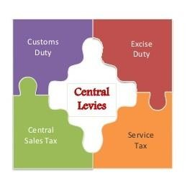
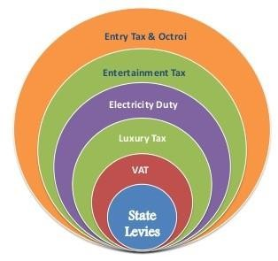
Central Taxes
Multiple State Taxes
Single Tax-GST
Tax
Administrations
Multiple State Tax Administrations
Single Tax Administration
CEx/ST Act & Rules
Multiple Acts & Rules
Uniform law
Procedures
Multiple procedures
Computerized
uniform procedures
Pre-GST Indirect tax structure in India
GST
GST
CGST
SGST/UTGST
IGST
CGST
SGST/UTGST
IGST
GST Structure in India

Slide 22

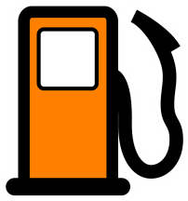









Outside GST !
Alcohol for human consumption
Power to tax remains with the State
Five petroleum products – crude oil
, diesel, petrol, natural gas and ATF
GST Council to decide the date from which GST will be applicable
Part of GST but power to levy additional excise duty with Central Government
Tobacco
Entertainment tax
levied by local bodies
Power to tax remains with local bodies
8

Slide 23
GST Council – Constitution (Article 279A of the Constitution)
Chairperson – Union FM
Vice Chairperson - to be chosen amongst the Ministers of State Government
Members - MOS (Finance) and all Ministers of Finance / Taxation of each State
Quorum is 50% of total members
States - 2/3 weightage and Centre - 1/3 weightage
Decision by 75% majority
Council to make recommendations on everything related to GST including laws, rules and rates etc.

Slide 24
Now, let’s look at how the weighted voting system works.
In terms of Clause 9 of the Article 279A, the “weighted votes of the members present and voting” in favour of a proposal in the GST Council shall be determined as under:
T = C + S
Where,
T = Total weighted votes of all members in favour of a proposal.
C = Weighted vote of the Centre = 1/3 i.e., 33.33%
S = Weighted votes of the States in favour of a proposal.
Calculation of Weighted Vote of the Centre, C
This calculation is very easy. Where Centre is in favour of proposal, it will be 1 x 1/3 = 1/3 or say 33.33%. However, if Centre is not favour in proposal, the weighted vote of
Centre will be 0 x 1/3 = 0.

Slide 25
Calculation of Weighted Vote of the States, S
S = W x F/P
Where,
W = Weighted allocated to all States present and voting i.e., i.e., 2/3 or 66.67%
F = Number of States voting in favour of a proposal.
P = Number of States present and voting.
For example, if 24 states are present (P) and 18 states are in favour (F) of a proposal.
The Weight of State (W) would be 2/3 x 18/24 = ½ = 50%. So, on a proposal,
if Centre is also in favour, in the above example,
Total Weighted Votes of all members (T) shall be 83.33% (33.33% + 50%) and
the proposal shall be passed.

Slide 26
What will be the situation in case Centre is against the Proposal?
Every decision of the GST Council will be taken by a majority of not less than three-fourths of weighted votes (75%) of the members present and voting.
The Centre’s share of weight is either 33.33% (if it is in favour) or
0% (if Centre is not in favour).
he minimum requirement is that three-fourth of weighted votes must be in favour of
proposal. Thus, if Centre is against the proposal, then the weighted vote cannot reach 75%. Even if all the states agree to any proposal their total weight will be only 66.67%.

Slide 28


Dual Concurrent GST Model
When UTGST would
be charged?
Supply
List of UT –
Andaman and Nicobar,
Chandigarh,
Dadra and Nagar Haveli
and Daman and Diu,
Lakshadweep,
Ladakh and
With Legislature
Puducherry.
National Capital
Territory of Delhi,
Jammu and Kashmir,
Intra State
Inter State
SGST/ UTGST
CGST
IGST

Slide 29




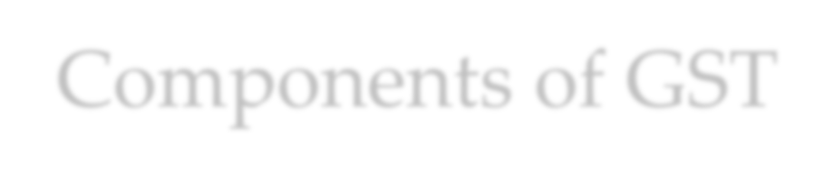


Components of GST
Central GST (CGST) - Levy on supply of ALL goods and/ or services within a particular State, by the Central Government
State GST (SGST) - Levy on supply of ALL goods and/ or services within a particular State, by the respective State Government
Integrated GST (IGST) – Levy on ALL inter-State supplies of
goods and/ or services, by the Central Government

Slide 30

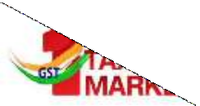




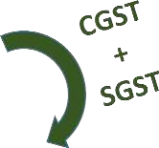




Levy of CGST, SGST, UTGST & IGST
State 1
Foreign
Territory
Union Territory
without Legislature
State 2
Union territory with legislature
18

Slide 31
Goods and Services Tax (GST)
GST stands for Goods and Services Tax, which is a destination based value added tax charged on the production, sale and consumption of goods and services. It is important to note that GST applies to the value addition at each stage, and no other tax would be levied, which results in the elimination of cascading effect.
In this system, the supplier of the goods or services is eligible to avail input tax credit, i.e. the GST paid on the purchase of goods, will be set off against the GST payable on the supply of goods and services. So, ultimately, the end consumer, bears the tax imposed by the last supplier in the distribution chain

Slide 32
Goods and Services Tax (GST)
In India, Dual GST has been implemented, which is simultaneously levied by the Central and State government to tax goods and services. The Centre charges the tax on intrastate sales, called as CGST. States charges tax on the services, called SGST and UTGST in case of Union Territories. For the interstate supply of goods and services that are taxable, are covered under IGST, i.e. Integrated Goods and Services Tax.
There are many indirect taxes, which are subsumed after the introduction of GST in India, which are as under:
At CGST level: Excise Duty, Service tax, surcharge and cess
At SGST level: Octroi or Entry tax, VAT, luxury tax, surcharge and cess
At IGST level: Central Sales Tax
GST slabs are fixed at 5%, 12%, 18% and 28%.
0% for essential items, 5% for basic necessities, 12% for standard goods, 18% for most consumer products, and 28% for luxury and sin goods.

Slide 33
Goods and Services Tax (GST)
Impact of GST on Consumers
Simpler Tax system
Reduction in prices of goods & services due to elimination of repeated taxes
Uniform prices throughout the country
Transparency in taxation system
Increase in employment opportunities

Slide 34
Goods and Services Tax (GST)
Impact of GST on Traders
Reduction in multiplicity of taxes
Reducing double taxation through input tax credit
More efficient neutralisation of taxes
especially for exports
Development of common national market
Simpler tax rules
Fewer rates and exemptions
Distinction between Goods & Services no longer required

Slide 35
Benefits of GST (1/2)
1
Reduction in Cascading of Taxes
Decrease in Inflation
2
Overall Reduction in Prices
3
Common National Market
Ease of Doing Business
4
Benefits to Small Taxpayers
5
Self-Regulating Tax System
Decrease in “Black” Transactions
6
Non-Intrusive Electronic Tax Syste
m
20

Slide 36
Benefits of GST (2/2)
Simplified Tax Regime
More informed consumer
7
8
Reduction in Multiplicity of Taxes
9
Consumption Based Tax
Poorer States to Gain
Abolition of CST
10
Exports to be Zero Rated
Make in India
11
12
Protection of Domestic Ind. - IGST
21

Slide 37
Reduction in Price of Goods under GST
All other taxes are replaced by GST
Cumulative taxes of 32% levied
Rs. 132
Rs. 128
Service
Tax – 1%
VAT 14.5%
32%
Entry
Tax 2%
Excise 12.5%
28%
CST 2%
GST @ 28%
Rs. 100
Rs. 100
Cost of production of goods is Rs. 100
Overall incidence of tax will be reduced
21

Slide 38
Reduction in Price of Goods under GST
Service tax replaced by GST
Service tax 15% and embedded VAT of ~3%
Rs. 115
Rs. ~115
15%
Service
Tax
18%
Rs. 100
GST
Rs. 97
VAT
Rs. 97
Cost of production of goods is Rs. 97
Overall incidence of tax will be same
22

Slide 39
GST - Impact on Cost and ITC
A Ltd
Selling Price | 1000
GST @ 12% | ?
Total | ?
Tax Payable | ?
Less: Input tax Credit | 80
Net Payment | ?
 | B Ltd
Cost | ?
Profit | 1,000
Total Taxable Value | ?
GST @18% | ?
Total Invoice | ?
Tax Payable | ?
Less: Input tax Credit | ?
Net Payment (in Cash) | ?
Type of Ledger in GST ?

Slide 40
GST - Impact on Cost and ITC
 | A Ltd
Selling Price | 1000
GST @ 12% | 120
Total | 1120
Tax Payable | 120
Less: Input tax Credit | 80
Net Payment | 40
 | B Ltd
Cost | 1,000
Profit | 1,000
Total Taxable Value | 2,000
GST @18% | 360
Total Invoice | 2,360
Tax Payable | 360
Less: Input tax Credit | 120
Net Payment (in Cash) | 240
Electronic Credit Ledger
Electronic
Cash Ledger

Slide 41
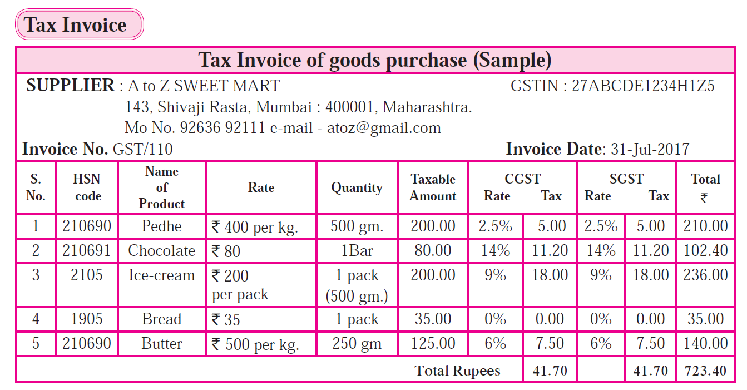
Goods and Services Tax (GST)

Slide 42
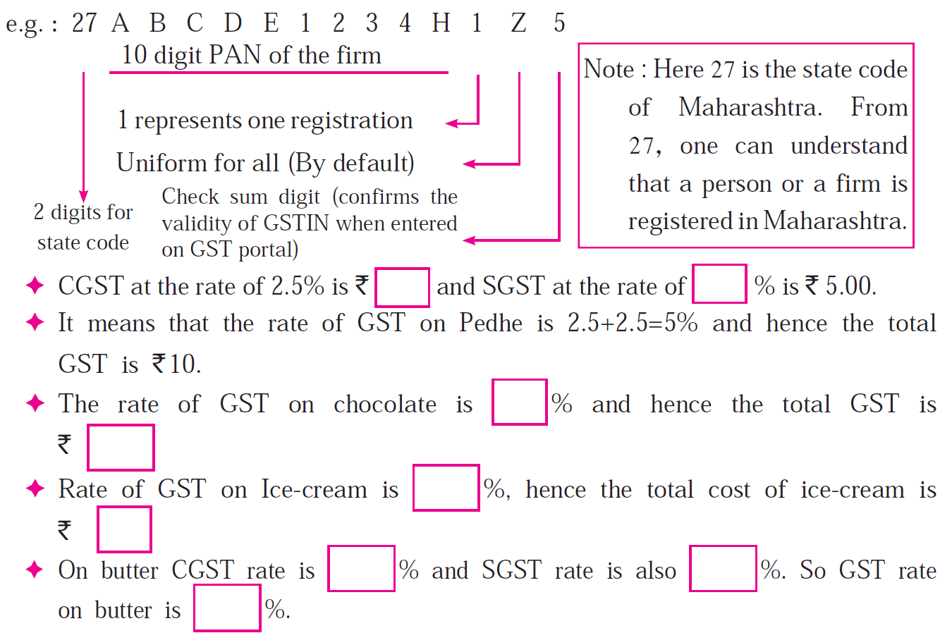
Goods and Services Tax (GST)

Slide 43
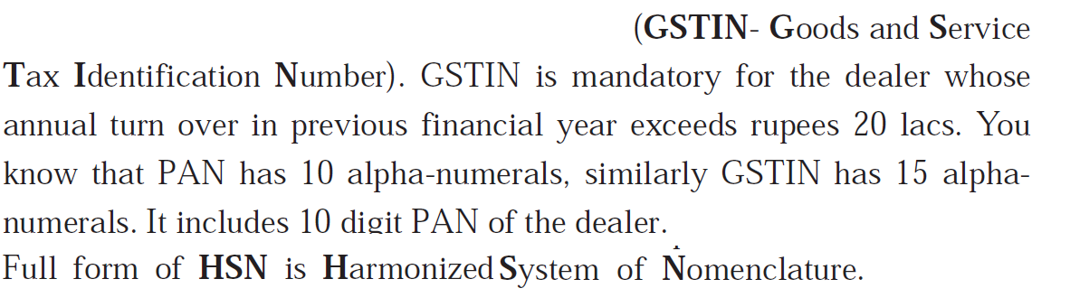
Goods and Services Tax (GST)

Slide 44
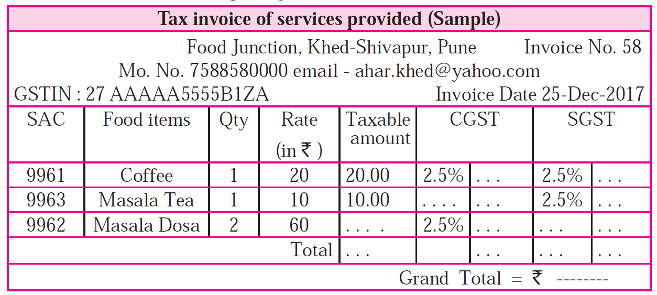
Goods and Services Tax (GST)

Slide 45
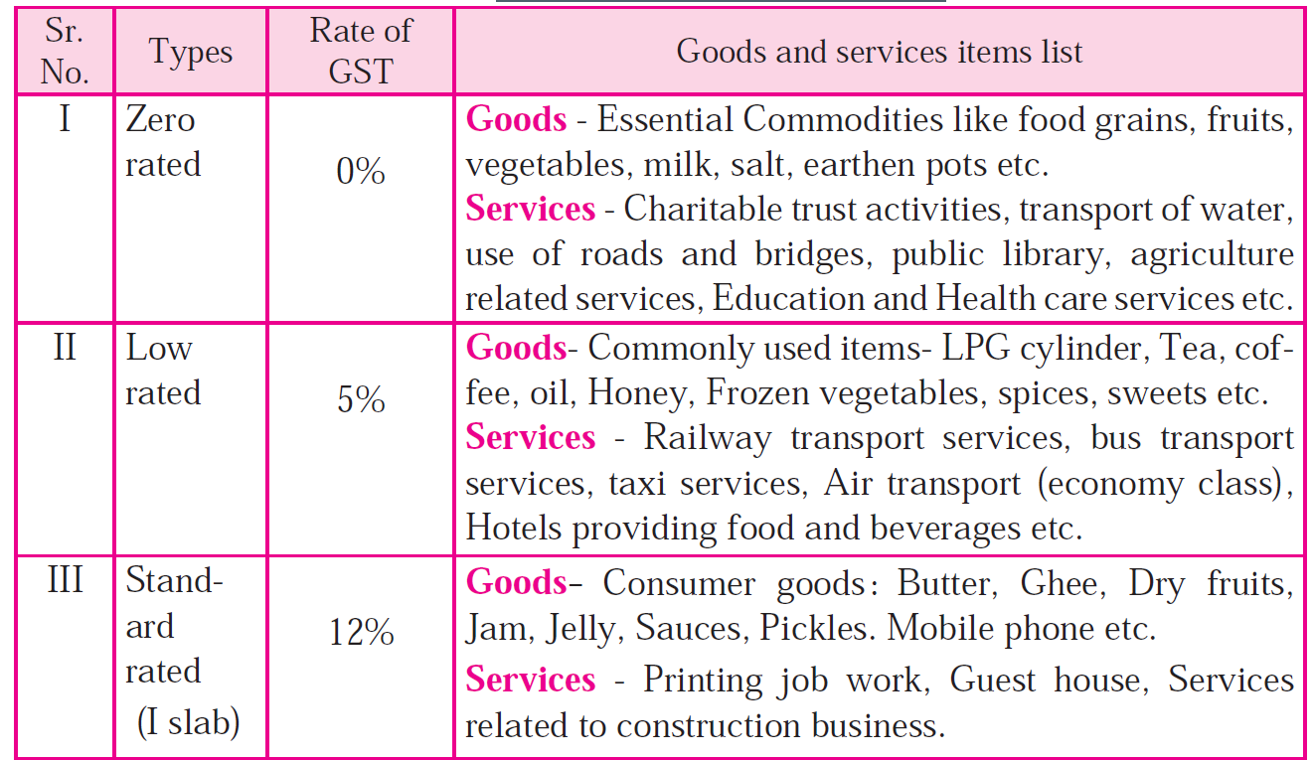
GST Slab

Slide 46
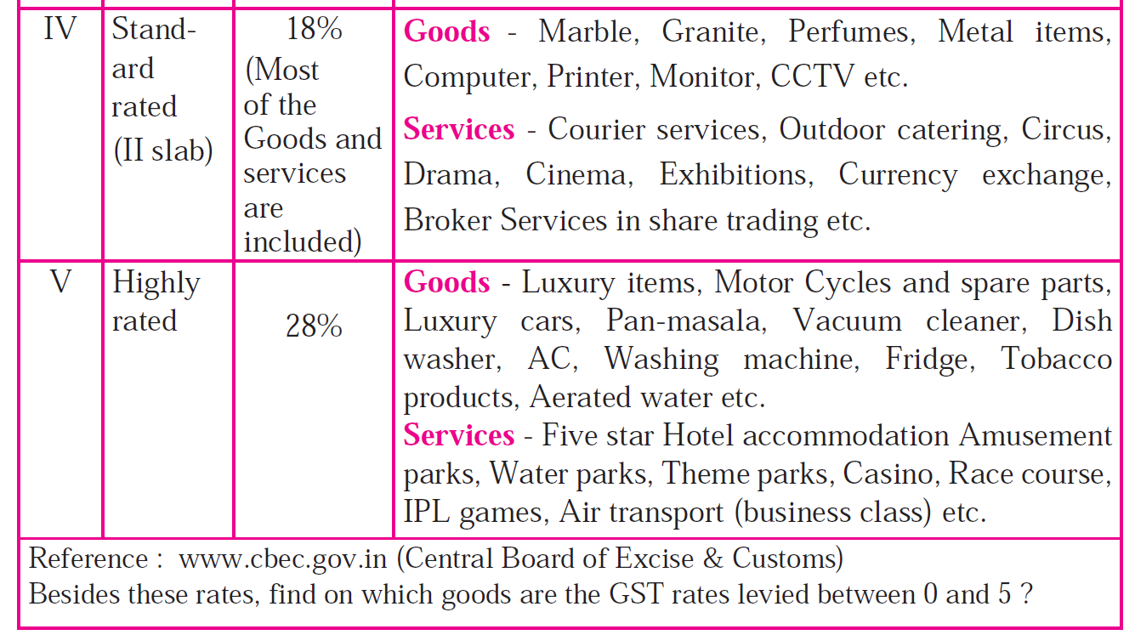
GST Slab

Slide 47
VAT v/s GST
BASIS FOR COMPARISON | VAT | GST
Meaning | VAT is a consumption tax, that is levied on the value addition, at each stage of production / distribution of goods. | GST is a destination based tax, charged on the manufacture, sale and consumption of goods and services.
Point of taxation | Sale of goods | Supply of goods and services
Payment Mode | Offline | Online
Registration | Compulsory if turnover is greater than 10 lakhs. | Compulsory if turnover is greater than 20 lakhs.
Basis of taxation | Summary based | Transaction based
Revenue Collection | Seller state collects revenue | Consumer state collects revenue
Excise Duty | It is levied, on the manufacture of excisable goods. | It is not levied.
Interstate sales | Input credit is not possible in case of interstate sales. | Input credit can be availed in case of interstate sales.

Slide 48
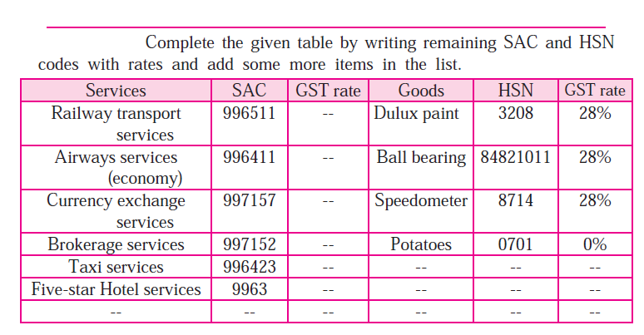
Goods and Services Tax (GST)
Service accounting code (SAC) Harmonized System of Nomenclature (HSN)

Slide 49
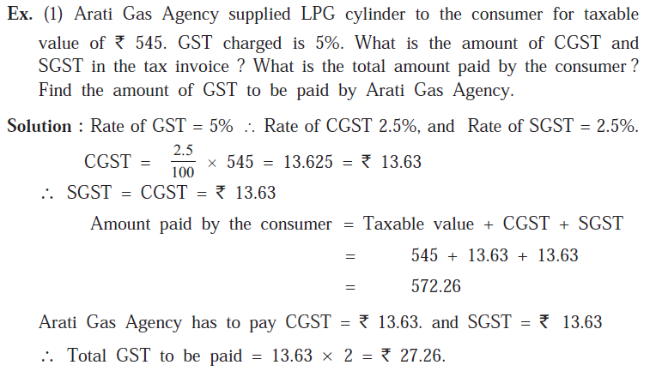
Goods and Services Tax (GST)

Slide 50
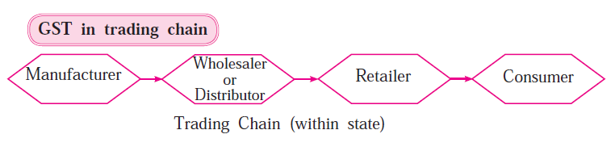
Goods and Services Tax (GST)

Slide 51
Goods and Services Tax (GST)
What is Input Tax Credit ? (ITC)
GST is levied and collected at every stage of trading from manufacturer to consumer. When trader pays GST at the time of purchase, it is called 'Input tax' and he collects GST at the time of sale which is called 'Output tax'.
At the time of paying GST to the government a trader deducts the input tax from the output tax and pays the remaining tax. This deduction of input tax is called Input Tax Credit.
GST payable = Output tax - ITC
In short, while paying taxes to the government each trader in the trading chain subtracts the tax paid at the time of purchase from the tax collected at the time of sale and pays the remaining tax.

Slide 52
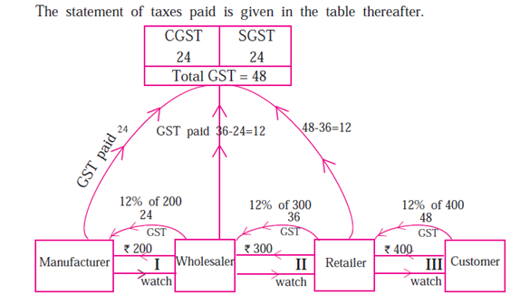
Goods and Services Tax (GST)
Suppose manufacturer of a watch has sold one watch for `200. (including profit) to the wholsaler. Wholesaler sold that watch for`300 to the retailer. Retailer sold it to the customer for ` 400. Rate of GST charged at every stage is 12%. Then how each trader pays GST and takes his input tax credit (ITC) at every stage of transaction is shown in the following flow-chart. Observe and study it.

Slide 53
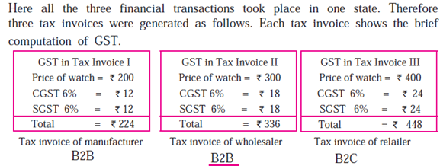
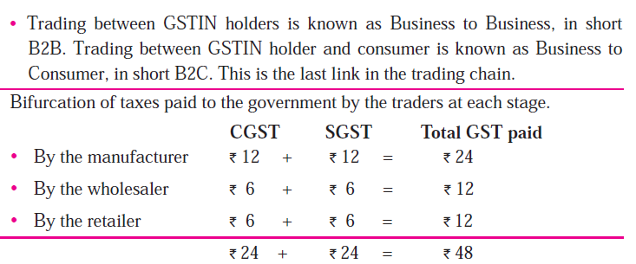
Goods and Services Tax (GST)

Slide 54
Goods and Services Tax (GST)
Who is covered by GST?
All the businesses except agriculture and having aggregate turnover above Rs. 20 lakh in a financial year are liable to pay GST.
For NRI doing business in India, it is mandatory to register under GST irrespective of the turnover of his business.
Who is exempted by GST?
Essential commodities like food grain, fruits, vegetables, milk, salt etc. and services like charitable trust activities, transport of water, agriculture related services, education and health care services etc.

Slide 55

Threshold Limits - Goods
Turnover of Goods | Applicable Taxes
Below Rs. 10 Lacs. | Neither State GST nor Central GST
Between Rs. 10 Lacs and Rs. 150 Lacs | Only State GST
Above Rs. 150 Lacs | Both State GST and Central GST

Slide 56

Threshold Limits - Services
Turnover of Services | Applicable Taxes
Below Rs. 10 Lacs | Neither State GST nor Central GST
Between Rs. 10 Lacs and (β figure) | Only State GST
Above β figure | Both State GST and Central GST
*Note: Figure β would be appropriately high, may be at or around Rs. 150 Lacs.

Slide 57

Illustration on Tax Credit
Supplier | Input Cost | Value added | Sale price | Rate of GST | GST - output | Tax credit | Net GST payable
Manufactu rer | 100 | 30 | 130 | 10% | 13 | 10 | 13-10 = 3
Whole seller | 130 | 20 | 150 | 10% | 15 | 13 | 15-13 = 2
Retail Seller | 150 | 10 | 160 | 10% | 16 | 15 | 16-15 = 1

Slide 58
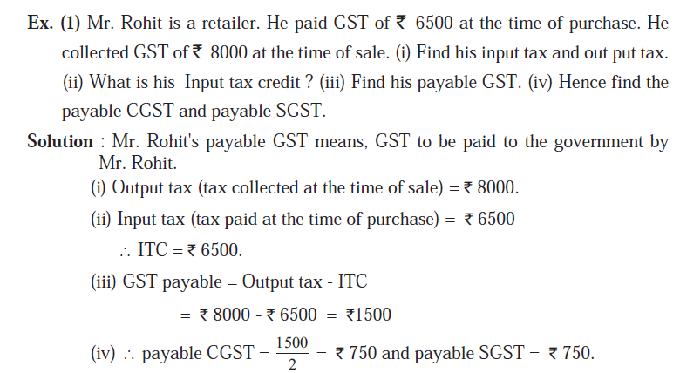
Goods and Services Tax (GST)

Slide 59
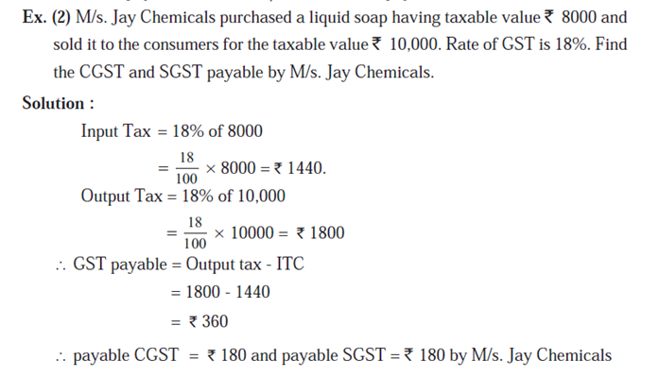
Goods and Services Tax (GST)

Slide 60
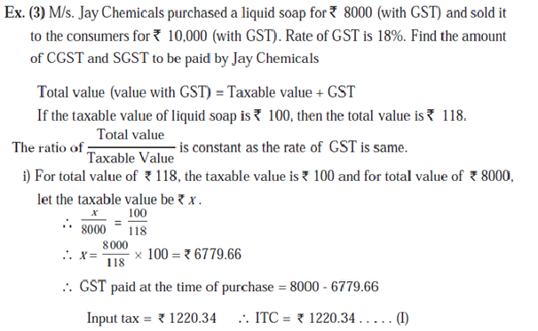
Goods and Services Tax (GST)

Slide 61
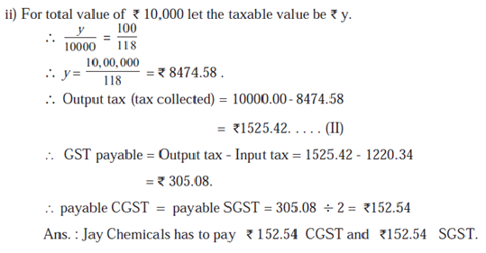
Goods and Services Tax (GST)

Slide 62
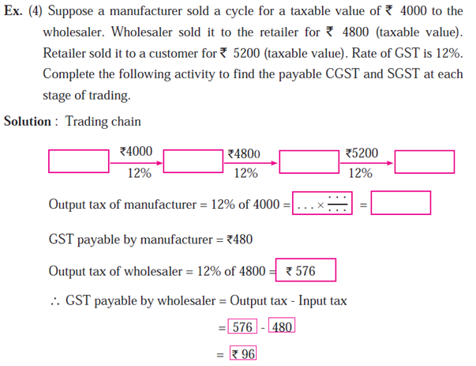
Goods and Services Tax (GST)

Slide 63
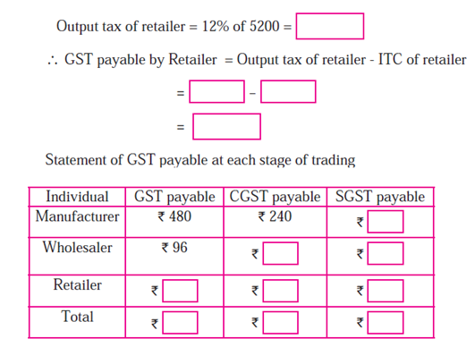
Goods and Services Tax (GST)

Slide 64
Levy & Collection
Services
Goods
1: Subject
Goods as services
2: Supply
Included
Implied
Excluded
3: Place
Inter-State
Intra-State
4: Time
Specified for goods
Specified for services

Slide 65
Levy and Collection of GST
Taxable event: Taxable event is very important matter in every tax law. Its determination is most crucial for the proper implementation of any tax law. Taxable event is that on the happening of which the charge is fixed. It is that event which on its occurrence creates or attracts the liability to tax. Sales, purchase, removal of goods, services, luxury, entertainment and so on, the list goes on.
Taxable event under GST: One of the very important feature of the regime of GST is the complete change in the taxable event different altogether from the taxable events witnessed in the indirect taxes as yet. The taxable event in the GST would be supply of goods and/or services.
As per Article 366(1A) of Constitution of India, Goods and Services Tax means a tax on supply of goods or services or both except taxes on supply of alcoholic liquor for human consumption.

Slide 66
Time, Place and Value of Supply
Time of supply means the point in time when goods/services are considered supplied’. When the seller knows the ‘time’, it helps him identify due date for payment of taxes.
Place of supply is required for determining the right tax to be charged on the invoice, whether IGST or CGST/SGST will apply.
Value of supply is important because GST is calculated on the value of the sale. If the value is calculated incorrectly, then the amount of GST charged is also incorrect

Slide 67
Time of Supply of Goods
Time of supply of goods is earliest of:
1. Date of issue of invoice
2. Last date on which invoice should have been issued
3. Date of receipt of advance/ payment*.
For example:
Mr. X sold goods to Mr. Y worth Rs 1,00,000. The invoice was issued on 15th January. The payment was received on 31st January. The goods were supplied on 20th January.

Slide 68
Time of Supply of Goods
Let us analyze and arrive at the time of supply in this case.
Time of supply is earliest of –
Date of issue of invoice – 15th January
Last date on which invoice should have been issued – 20th January.
Thus the time of supply is 15th January.
What will happen if, in the same example an advance of Rs 50,000 is received by Mr. X on 1st January?
The time of supply for the advance of Rs 50,000 will be 1st January (since the date of receipt of advance is before the invoice is issued). For the balance Rs 50,000, the time of supply will be 15th January.

Slide 69
Time of Supply for Services
Time of supply of services is earliest of:
Date of issue of invoice
Date of receipt of advance/ payment.
Date of provision of services (if invoice is not issued within prescribed period)
Let us understand this using an example:
Mr. A provides services worth Rs 20000 to Mr. B on 1st January. The invoice was issued on 20th January and the payment for the same was received on 1st February.

Slide 70
Time of Supply for Services
In the present case, we need to 1st check if the invoice was issued within the prescribed time.
The prescribed time is 30 days from the date of supply i.e. 31st January. The invoice was issued on 20th January. This means that the invoice was issued within a prescribed time limit.
The time of supply will be earliest of –
Date of issue of invoice – 20th January
Date of payment = 1st February
This means that the time of supply of services will be 20th January.

Slide 71
Time of Supply under Reverse Charge
In case of reverse charge the time of supply for service receiver is earliest of:
Date of payment*
30 days from date of issue of invoice for goods (60 days for services)
For example:
M/s ABC Pvt. Ltd undertook service of a director Mr. X worth Rs. 50,000 on 15th January. The invoice was raised on 1st February. M/s ABC Pvt Ltd made the payment on 1st May.
The time of supply, in this case, will be earliest of –
Date of payment = 1st May
60 days from date of issue of invoice – 2nd April
Thus, the time of supply of services is 2nd April.

Slide 72
Place of Supply
It is very important to understand the term ‘place of supply’ for determining the right tax to be charged on the invoice.
Here is an example:
Location of Service Receiver | Place of supply | Nature of Supply | GST Applicable
Maharashtra | Maharashtra | Intra-state | CGST + SGST
Maharashtra | Kerala | Inter-state | IGST

Slide 73
Place of Supply of Goods
Usually, in case of goods, the place of supply is where the goods are delivered.
So, the place of supply of goods is the place where the ownership of goods changes.
What if there is no movement of goods. In this case, the place of supply is the location of goods at the time of delivery to the recipient.
For example: In case of sales in a supermarket, the place of supply is the supermarket itself.
Place of supply in cases where goods that are assembled and installed will be the location where the installation is done.
For example, A supplier located in Kolkata supplies machinery to the recipient in Delhi. The machinery is installed in the factory of the recipient in Kanpur. In this case, the place of supply of machinery will be Kanpur.

Slide 74
Place of Supply for Services
Generally, the place of supply of services is the location of the service recipient.
In cases where the services are provided to an unregistered dealer and their location is not available the location of service provider will be the place of provision of service.
Special provisions have been made to determine the place of supply for the following services:
Services related to immovable property
Restaurant services
Admission to events
Transportation of goods and passengers
Telecom services
Banking, Financial and Insurance services.
In case of services related to immovable property, the location of the property is the place of provision of services.

Slide 75
Place of Supply for Services
Example 1:
Mr. Anil from Delhi provides interior designing services to Mr. Ajay(Mumbai). The property is located in Ooty(Tamil Nadu).
In this case, place of supply will be the location of the immovable property i.e. Ooty, Tamil Nadu.
Example 2:
A registered taxpayer offers passenger transport services from Bangalore to Hampi. The passengers do not have GST registration. What will be the place of supply in this case?
The place of supply is the place from where the departure takes place i.e. Bangalore in this case.

Slide 76
Illustrations
 | Supply | Supplier | Place of Supply | Result
 | Goods | Karnataka | Tamil Nadu | Inter-State (IGST)
 | Services | Pondicherry | Kerala | Inter-State (IGST)
 | Goods | Chandigarh* | Chandigarh* | Inter-State (IGST)
 | Services | Chandigarh* | Punjab | Inter-State (IGST)
 | Goods | Punjab | Chandigarh* | Inter-State (IGST)
 | Goods | Delhi | Delhi | Intra-State (CGST/SGST)
 | Services | Rajasthan | Rajasthan | Intra-State (CGST/SGST)
Note: Chandigarh is a UT without Legislature;
Explanation to Section 2(2) provides that the term “State” includes a UT with Legislature (Of the 7 UTs, Delhi and Pondicherry are the only 2 UTs with Legislature). In case of a Union Territory if it adopts the legislature of a particular State say Punjab, then it will be intra-State supply.

Slide 77
Place of Supply When There is Movement of Goods
Supply Type | Place of supply
Involves movement of goods, whether by supplier, or buyer or by any other person | Location of the goods when the movement of goods terminates for delivery to the recipient.
Goods are delivered by the seller to the buyer on the directions of a third party (whether or not an agent), before or during the movement of goods, by the way of transfer of title in goods or the documents or some other way | It is assumed that the third person has received the goods and therefore, the place of supply of the goods will be the principal place of business of the third party.

Slide 78
Place of Supply When There is Movement of Goods
Example 1- Intra-state sales Mr. Raj of Mumbai, Maharashtra sells 10 TV sets to Mr. Vijay of Nagpur, Maharashtra
The place of supply is Nagpur in Maharashtra. Since it is the same state CGST & SGST will be charged.
Example 2-Inter-State sales Mr. Raj of Mumbai, Maharashtra sells 30 TV sets to Mr. Vinod of Bangalore, Karnataka
The place of supply is Bangalore in Karnataka. Since it is a different state IGST will be charged.

Slide 79
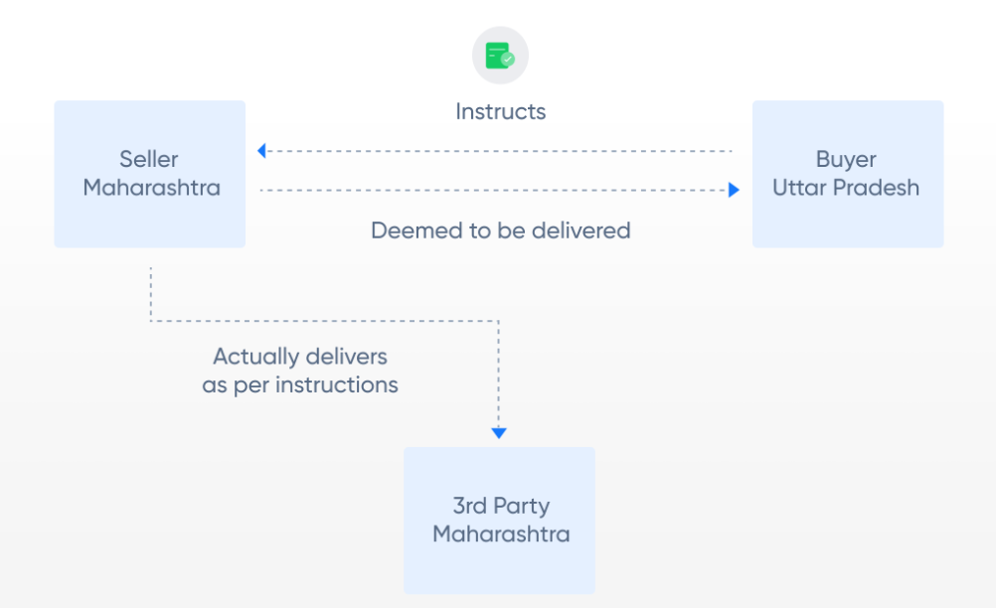
Place of Supply When There is Movement of Goods
Example 3- Deliver to a 3rd party as per instructions Anand in Lucknow buys goods from Mr. Raj in Mumbai (Maharashtra). The buyer requests the seller to send the goods to Nagpur (Maharashtra)
In this case, it will be assumed that the buyer in Lucknow has received the goods & IGST will be charged. Place of supply: Lucknow (UP) GST: IGST

Slide 80
Place of Supply – No Movement of Goods
Example 1- No movement of goods Sales Heaven Ltd. (Chennai) opens a new showroom in Bangalore. It purchases a building for showroom from ABC Realtors (Bangalore) along with pre-installed workstations
Place of supply: Bangalore GST: CGST & SGST There is no movement of goods (work stations), so the place of supply will be the location of such goods at the time of delivery (handing over) to the receiver.
Supply Type | Place of Supply
No movement of goods, either by the supplier or by the recipient | Location of those goods at the time of delivery to the recipient (at the time of ownership transfer)
Goods are assembled or installed at site | Place of installation or assembly

Slide 81
Place of Supply – No Movement of Goods
Example 2- Installing goods Strong Iron & Steel Ltd. (Jharkhand) asks M/s SAAS Constructions (West Bengal) to build a blast furnace in their Jharkhand steel plant
Place of supply: Jharkhand GST: CGST & SGST Although M/s SAAS is in West Bengal, the goods (blast furnace) is being installed at site in Jharkhand which will be the place of supply.
Particulars | Location of the supplier | Location of the recipient ( Registered office) | Site of the assembly /installation | Place of supply | GST
Goods are assembled or installed at site | West Bengal | Orissa | Jharkhand | Jharkhand | CGST+SGST (Jharkhand)
 | Jharkhand | Jharkhand | Jharkhand | Jharkhand | CGST+SGST (Jharkhand)
 | Jharkhand | Jharkhand | Orissa | Orissa | CGST+SGST (Orissa)
 | Jharkhand | Jharkhand | Tamil Nadu | Tamil Nadu | CGST+SGST (Tamil Nadu)
 | Jharkhand | Tamil Nadu | Jharkhand | Jharkhand | CGST+SGST (Jharkhand)

Slide 82
Place of Supply- Goods Supplied on a Vessel/Conveyance
Example 1- Plane Mr. Ajay is travelling from Mumbai to Delhi by air. He purchases coffee and snacks while on the plane. The airline is registered in both Mumbai and Delhi.
Place of supply: Mumbai GST: CGST & SGST The food items were loaded into the plane at Mumbai. So, the place of supply becomes Mumbai.
Example 2- Plane- Business travel Mr. Ajay is travelling from Mumbai to Chennai by air on behalf of his company Ram Gopal and Sons (registered in Bangalore). In the plane he purchases lunch. The airline is registered in Mumbai & Chennai.
Place of supply: Mumbai GST: CGST & SGST The food items were loaded into the plane at Mumbai. So, the place of supply becomes Mumbai. It does not matter where the buyer is registered.
Supply Type | Place of Supply
Goods are on board of a conveyance or vessel or train or aircraft or a motor vehicle | Location at which such goods are taken on board.

Slide 83
Place of Supply – Imports and Exports
Example 1- Import
Ms. Malini imports school bags from China for her shop (registered in Mumbai)
Place of supply: Mumbai GST: IGST
Example 2- Export
Ms. Anita (Kolkata) exports Indian perfumes to UK
Place of supply: Kolkata GST: Exempted
The place of supply of goods:
imported into India will be the location of the importer.
exported from India shall be the location outside India.
Supply Type | Place of Supply | GST
Goods imported into India | Location of the importer | Always IGST is charged for imports
Exported from India | Location outside India | GST on exports are eligible for refund

Slide 84
Valuation Rule for Supply Under Goods and Services Tax
1.Value of supply of goods or services where the consideration is not wholly in money
Where the supply of goods or services is for a consideration not wholly in money, the value of the supply shall be the open market value of such supply;
if open market value is not available, be the sum total of consideration in money and any such further amount in money as is equivalent to the consideration not in money if such amount is known at the time of supply;
if the value of supply is not determinable under clause (a) or clause (b), be the value of supply of goods or services or both of like kind and quality;
if value is not determinable under clause (a) or clause (b) or clause (c), be the sum total of consideration in money.
For Example: (i) Where a new phone is supplied for Rs. 20,000 along with the exchange of an old phone and if the price of the new phone without exchange is Rs. 24,000, the open market value of the new phone is Rs. 24,000.
(ii) Where a laptop is supplied for Rs. 40,000 along with a barter of printer that is manufactured by the recipient and the value of the printer known at the time of supply is Rs. 4,000 but the open market value of the laptop is not known, the value of the supply of laptop is Rs. 44,000

Slide 85
Valuation Rule for Supply Under Goods and Services Tax
2.Value of supply of goods or services or both between distinct or related persons, other than through an agent The value of the supply of goods or services or both between distinct persons as specified in sub-section (4) and (5) of section 25 or where the supplier and recipient are related, other than where the supply is made through an agent, shall be the open market value of such supply;
if open market value is not available, be the value of supply of goods or services of like kind and quality;
if value is not determinable under clause (a) or (b), be the value as determined by application of rule 4 or rule 5, in that order:
Provided where the recipient is eligible for full input tax credit, the value declared in the invoice shall be deemed to be the open market value of goods or services.

Slide 86
Valuation Rule for Supply Under Goods and Services Tax
3. Value of supply of goods made or received through an agent The value of supply of goods between the principal and his agent shall be the open market value of the goods being supplied, or at the option of the supplier, be 90% of the price charged for the supply of goods of like kind and quality by the recipient to his customer not being a related person, where the goods are intended for further supply by the said recipient;
For Example:
Where a principal supplies groundnut to his agent and the agent is supplying groundnuts of like kind and quality in subsequent supplies at a price of Rs. 5000 per quintal on the day of supply. Another independent supplier is supplying groundnuts of like kind and quality to the said agent at the price of Rs. 4550 per quintal. The value of the supply made by the principal shall be Rs. 4550 per quintal or where he exercises the option the value shall be 90% of the Rs. 5000 i.e. is Rs. 4500 per quintal.

Slide 87
Valuation Rule for Supply Under Goods and Services Tax
4.Value of supply of goods or services or both based on cost
Where the value of a supply of goods or services or both is not determinable by any of the preceding rules, the value shall be one hundred and ten percent of the cost of production or manufacture or cost of acquisition of such goods or cost of provision of such services.
5. Residual method for determination of value of supply of goods or services or both
Where the value of supply of goods or services or both cannot be determined under rules 1 to 4, the same shall be determined using reasonable means consistent with the principles and general provisions of section 15 and these rules. Provided that in case of supply of services, the supplier may opt for this rule, disregarding rule 4. This is a general residual rule, to be used as a last resort. This is again open ended and refers to principles and general provisions as per law and other rules.

Slide 88
Valuation Rule for Supply Under Goods and Services Tax
6.Determination of value in respect of certain supplies
The value in respect of supplies specified below shall be determined in the manner provided hereinafter. Rule-32(2) Purchase/ Sale of Foreign Currency – The value of supply of services in relation to purchase or sale of foreign currency, including money changing, shall be determined by the supplier of service in the following manner:-
(i) For a currency, when exchanged from, or to, Indian Rupees (INR), the value shall be equal to the difference in the buying rate or the selling rate, as the case may be, and the Reserve Bank of India (RBI) reference rate for that currency at that time, multiplied by the total units of currency.
(ii) At the option of supplier of services, the value in relation to supply of foreign currency, including money changing, shall be deemed to be

Slide 89
Valuation Rule for Supply Under Goods and Services Tax
1 % of the gross amount of currency exchanged for an amount up to one lakh rupees, subject to a minimum amount of two hundred and fifty rupees;
(ii) one thousand rupees(1,000) and half of a per cent (0.5%) of the gross amount of currency exchanged for an amount exceeding one lakh rupees and up to ten lakh rupees; and
(iii) five thousand rupees (5,000) and one tenth of a per cent (0.10%) of the gross amount of currency exchanged for an amount exceeding ten lakh rupees, subject to maximum amount of sixty thousand rupees.
7. Value of supply of services in case of pure agent Notwithstanding anything contained in these rules, the expenditure or costs incurred by the supplier as a pure agent of the recipient of supply of services shall be excluded from the value of supply, if all the following conditions are satisfied, namely: -
the supplier acts as a pure agent of the recipient of the supply, when he makes payment to the third party for the services procured;
the recipient of supply uses the services so procured by the supplier service provider in his capacity as pure agent of the recipient of supply;

Slide 90
Valuation Rule for Supply Under Goods and Services Tax
the recipient of supply is liable to make payment to the third party; the recipient of supply authorizes the supplier to make payment on his behalf;
the recipient of supply knows that the services for which payment has been made by the supplier shall be provided by the third party;
the payment made by the supplier on behalf of the recipient of supply has been separately indicated in the invoice issued by the supplier to the recipient of service;
the supplier recovers from the recipient of supply only such amount as has been paid by him to the third party; and
the services procured by the supplier from the third party as a pure agent of the recipient of supply are in addition to the supply he provides on his own account.

Slide 91
Valuation Rule for Supply Under Goods and Services Tax
8. Rate of exchange of currency, other than Indian rupees, for determination of value
The rate of exchange for determination of value of taxable goods or services or both shall be the applicable reference rate for that currency as determined by the Reserve Bank of India on the date when point of taxation arises.

Slide 92
GST exemption
What is a GST exemption?
Understanding the taxability of goods and services also includes knowing whether a good or service is exempted from GST registration. Upon knowing this, applicants can get clarity on several other factors. Essentially, the GST exemption limit for businesses depends on their annual aggregate turnover.
Previously, businesses with an annual turnover of up to Rs.20 lakhs did not need to register for GST. The amount was Rs.10 lakhs for North-eastern or hilly states like Meghalaya, Sikkim, Mizoram, Arunachal Pradesh, Nagaland, Himachal Pradesh, Manipur, Assam, Tripura, Uttarakhand, and Jammu & Kashmir.
As per the GST council meeting on 10th January 2019, the values doubled for Micro, Small, and Medium Enterprises (MSMEs) in both cases.

Slide 93
GST exemption
What is an exempt supply under GST?
Supplies | Meaning
Nil-rated | Supplies that have 0% tax rate. Example: Salt.
Non-GST | Ones that do not come under the purview of GST law include alcohol for human consumption.
Zero-rated | Export supplies to SEZ (Special Economic Zone) developers.
Exempt | Taxable supplies that do not attract GST. Curd, fruits are among some of the supplies.

Slide 94
Types of exemption in GST
Absolute: Exemptions without any conditions are an absolute exemption. For example, services by the RBI.
Conditional: Certain conditions are applicable to some exemptions. Services by hotels, clubs, etc., with a statement of accommodation unit less than Rs.1000 per day, fall under a conditional exemption.
Partial: Unregistered persons supplying goods within states (intrastate) to a registered individual can enjoy tax exemption under reverse charge only if the aggregate value of a supply does not exceed Rs.5000 per day.

Slide 95
GST exemption from registration
The following category of taxpayers need not register for GST:
Individuals belonging to the threshold exemption limit.
Exempt suppliers of goods and services.
A person supplying non-GST goods and services.
Taxpayers engaging in activities other than the supply of goods or services.
Agriculturists.
Ones supplying goods covered under reverse charge.

Slide 96
Exempted goods under GST
In the following section, you will find a list of the GST exempted goods in India:
Fresh and dry vegetables like potatoes, onions, and other leguminous vegetables.
Non-GST goods include fish, egg, fresh milk, etc.
Grapes, melons, ginger, garlic, unroasted coffee beans, green tea leaves that are not processed, and more.
Food items that are not put into branded containers like rice, hulled cereal grains, wheat, corn, etc.
Components like human blood.
Unspun jute fibres, raw silk, khadi fibre, etc.
Hearing aid manufacturing parts, chalks, slates, handloom, etc.

Slide 97
Exempted services under GST
A number of services qualify for GST exemption. Here is a GST exemption list of services for your reference:
Agricultural services, including harvesting, packaging, warehouse, cultivation, supply, leasing of machinery, are essentially GST exempt services. An exception to these exempted services includes the rearing of horses.
Public transportation services, auto-rickshaws, metered cabs, metro, etc.
Transportation of agricultural products and goods outside of India.
Labour supply for farms.
Goods transportation where the charges are less than Rs.1500.
Services like retail packing, pre-conditioning, waxing, etc.
Foreign diplomatic and government services.
Healthcare and educational services like mid-day meal catering, VET clinics, paramedics, etc. Ambulance and charity services also qualify for exemption under GST.
Services offered by RBI, IRDAI, Central and State Government, NPS and more.
Banking services like Basic Saving Bank Deposit (BSBD) account operable under the Pradhan Mantri Jan-Dhan Yojana (PMJDY).

Slide 98
Reasons for exemption under GST
The government decides on exempting goods from registering under GST in the following cases:
In case the GST council recommends the exemption.
The government might find certain exemptions from GST registration to be beneficial for the public.
Under exceptional or unforeseen situations, the government might grant exemption by special order.
Upon providing official notification, one can supply specific goods under a full exemption.
Therefore, from the points mentioned above, it is evident that several sectors can qualify for a GST exemption provided they fulfil some prerequisites. Knowing those criterias in detail will help a taxpayer to register under GST without any hassle.

Slide 99
GST exemption for start-ups and small businesses
Individuals aspiring to start a business can benefit greatly from the latest regulations of the GST scheme. Here are a few pointers to keep in mind regarding GST exemption for start-ups.
Any business with a turnover of less than Rs.40 lakhs is recognised as a GST-exempt business.
Businesses that have a lower annual aggregate turnover than Rs.1.5 crores can avail of a composition scheme under GST. The scheme allows individuals to pay taxes at a fixed rate depending on the turnover amount. The rate may vary between 1-6%.
Also, small businesses are exempted from e-invoicing under GST. However, businesses with a turnover of more than Rs.50 crores have to apply for e-invoicing mandatorily.
Small businesses with an income below Rs.5 crores can opt for a quarterly filing system.

Slide 100
GST Composition Scheme
Composition Scheme is a simple and easy scheme under GST for taxpayers. Small taxpayers can get rid of tedious GST formalities and pay GST at a fixed rate of turnover. This scheme can be opted by any taxpayer whose turnover is less than Rs. 1.5 crore*.
Who cannot opt for Composition Scheme
The following people cannot opt for the scheme-
Manufacturer of ice cream, pan masala, or tobacco
A person making inter-state supplies
A casual taxable person or a non-resident taxable person
Businesses which supply goods through an e-commerce operator

Slide 101
GST Composition Scheme
What are the conditions for availing Composition Scheme?
The following conditions must be satisfied in order to opt for composition scheme:
No Input Tax Credit can be claimed by a dealer opting for composition scheme
The dealer cannot supply goods not taxable under GST such as alcohol.
The taxpayer has to pay tax at normal rates for transactions under the Reverse Charge Mechanism
If a taxable person has different segments of businesses (such as textile, electronic accessories, groceries, etc.) under the same PAN, they must register all such businesses under the scheme collectively or opt out of the scheme.
The taxpayer has to mention the words ‘composition taxable person’ on every notice or signboard displayed prominently at their place of business.
The taxpayer has to mention the words ‘composition taxable person’ on every bill of supply issued by him.
As per the CGST (Amendment) Act, 2018, a manufacturer or trader can now also supply services to an extent of ten percent of turnover, or Rs.5 lakhs, whichever is higher. This amendment will be applicable from the 1st of Feb, 2019.

Slide 102
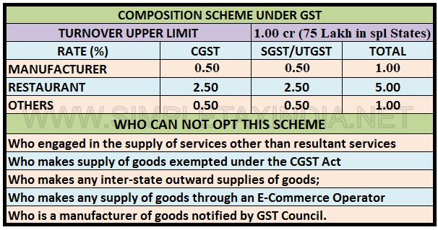
GST Composition Scheme

Slide 103
GST Composition Scheme
What are the advantages of Composition Scheme?
The following are the advantages of registering under composition scheme:
Lesser compliance (returns, maintaining books of record, issuance of invoices)
Limited tax liability
High liquidity as taxes are at a lower rate
What are the disadvantages of Composition Scheme?
Disadvantages of registering under GST composition scheme:
A limited territory of business. The dealer is barred from carrying out inter-state transactions
No Input Tax Credit available to composition dealers
The taxpayer will not be eligible to supply non-taxable goods under GST such as alcohol and goods through an e-commerce portal.

